Slide 1

Preliminary Design Review
Smart Pill Box
Oklahoma State University
Senior Design Spring 2023

Slide 2
Overview
Introduction
Project Description
Constraints
Electrical Components
Parts
Software Design
Frontend & Backend
Hardware Design
Design I, Design II, and Alternatives
Design Analysis & Decision Matrix
Testing and Experimentation
Project Plan
Risk Management
Hazard Analysis
Cost
Work Distribution
Questions
Zarek Rooker
2/2/2023

Slide 3



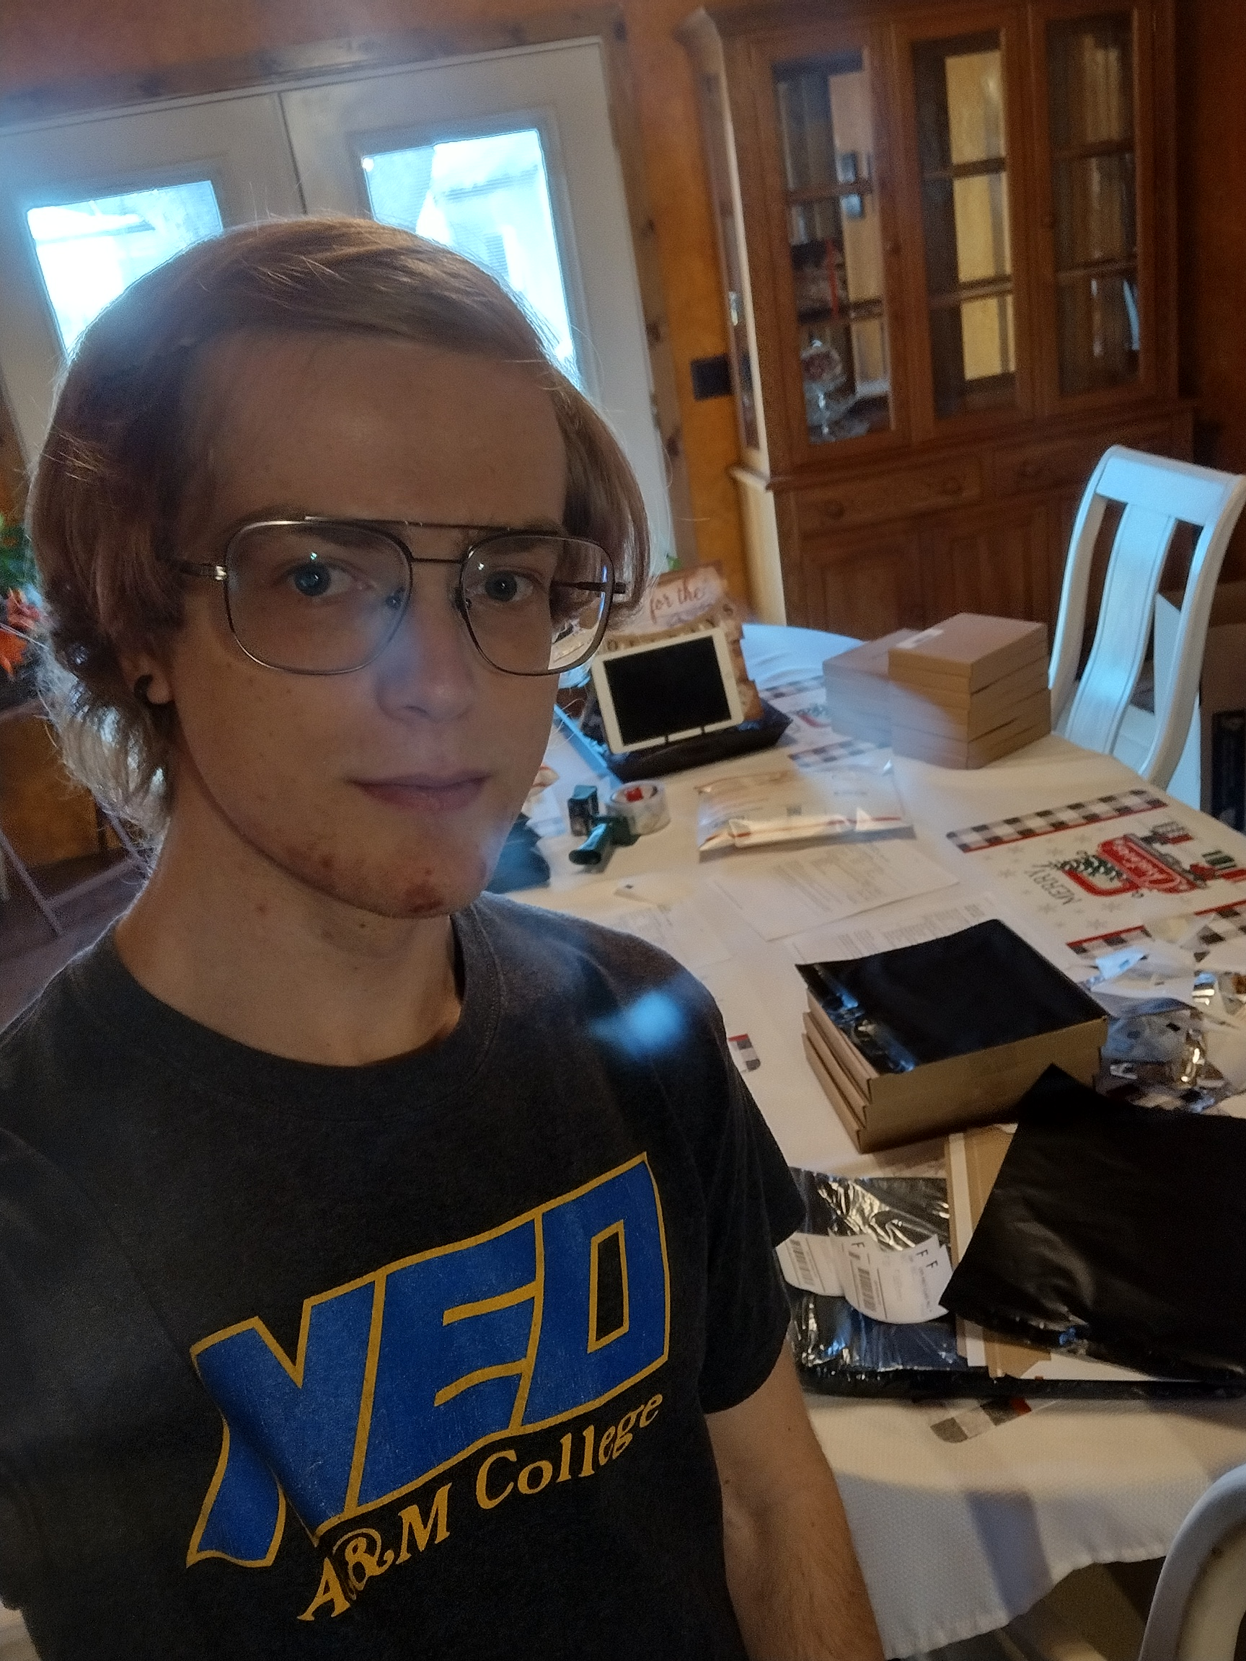
Team Introductions and Roles
Hardware Manager:
Zarek Rooker
E.E & C.E.
Circuit Designer:
Zahra Alnahwi
E.E
Backend Dev:
Stephen Fransen
E.E
UI Designer:
Daniel Jacobs
C.E.
Assignment:
Point of Contact
Hardware
Electronics
Assignment:
Component Research
Hardware
Electronics
Assignment:
Software
Server Building
Assignment:
Software
User Interface
Zarek Rooker
2/2/2023

Slide 4
Project Description
Project Vision:
The main vision of this project is to provide an efficient and safe way to manage medication for elderly patients, especially those with cognitive decline, memory loss, and visual impairments. The Smart Pill Box (SPB) can help them to take medication correctly and on time, reduce medication errors, and provide a better way for caregivers to monitor the medication adherence. The SPB can also provide a more convenient, user-friendly, and cost-effective solution compared to other existing solutions.
Zarek Rooker
2/2/2023

Slide 5
Design Constraints
Specifications
Store medicine for 7 days and for morning, noon, and evening
Lock/Unlock mechanism for medication
User interface with a touch screen
Speaker to remind the user to take medication
Camera to capture images of the user taking medication
Send notifications to caregivers upon completion of medication-taking
Store medication data in a remote cloud server
Optional:
Recognize pill types and quantity through images taken by the camera (optional)
Support user authorization through face recognition or fingerprint (optional)Multiple Compartments to store medicine
Zarek Rooker
2/2/2023

Slide 6
Consideration and Constraints
Statistics to Consider:
Average Adult takes 4 prescription medication
More than four in ten older adults take five or more prescription medications
Target Audience:
Elderly Patients
Considerations:
Ease of use: The design should be intuitive and easy to operate, allowing elderly users to quickly and easily access their medication
Lower risk of medicine contamination
Lower risk of accidental ingestion of medication
Accommodating for all
Zarek Rooker
2/2/2023
Notes:
Add my two facts into this slide!!

Slide 7
Consideration and Constraints
Environmental:
Energy efficient.
Recyclable/Compostable
Health:
Safe for Use
Properly Locking
List Medications
Safety:
Electrical shock or fire
Sharp edges & hazards
Sustainability:
Long life span
Refurbish/Reusable
Social:
Accessible and useable for all
Cultural:
Appropriate for target audience
Global:
Meets regulatory standards
Meets safety and performance requirements
Ethical:
Ethically produced and sourced
Professional:
Meets industry standard
Zarek Rooker
2/2/2023
Notes:
Add my two facts into this slide!!

Slide 8
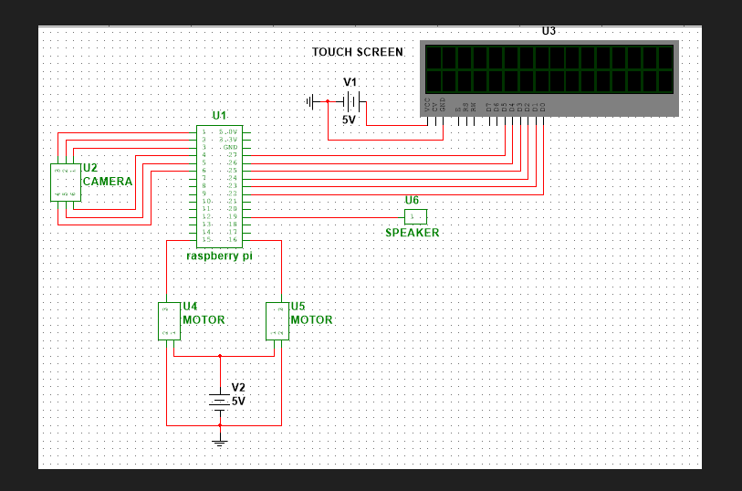
Schematic
Zahra Alnahwi
2/2/2023

Slide 9
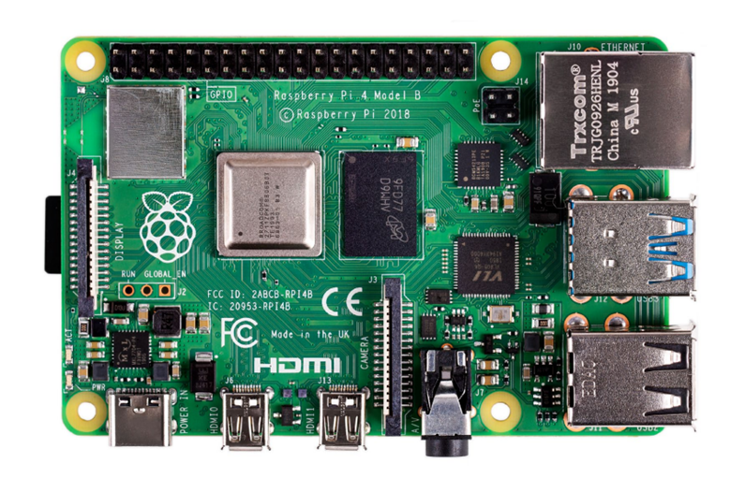
Microcontroller
RASPBERRY PI 4B/4GB
Can run on 5V/3A DC or 5.1V/ 3A DC
40 Digital I/O Pins
Programmed using python
$55
Zahra Alnahwi
2/2/2023

Slide 10
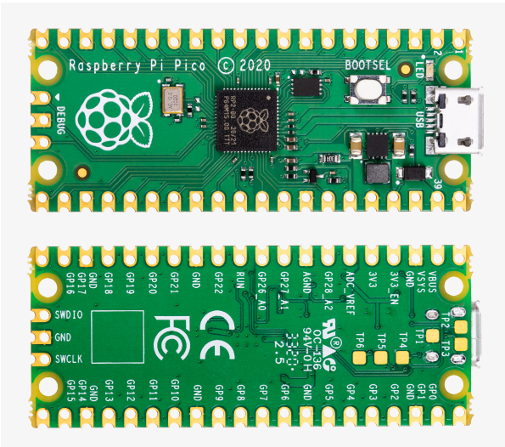
Microcontroller
Raspberry Pi Pico
Can run on 5V
23 Digital I/O Pins
3 Analog Digital Converter
Programmed using Python
$5
Zahra Alnahwi
2/2/2023

Slide 11
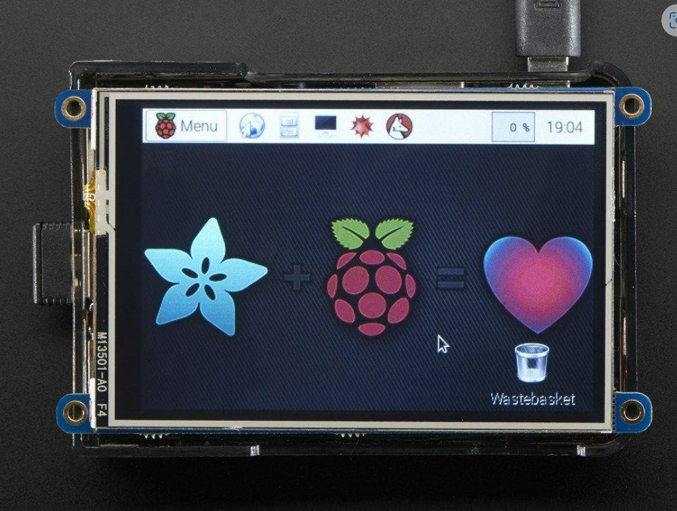
Touch Screen
3.5” Touch screen
PiTFT Plus 480x320 3.5" TFT+Touchscreen for Raspberry Pi
Display Development Tools 3.5" TFT Touchscreen for Raspberry Pi
Unit weight : 4.331466 oz
$44.95
Zahra Alnahwi
2/2/2023

Slide 12
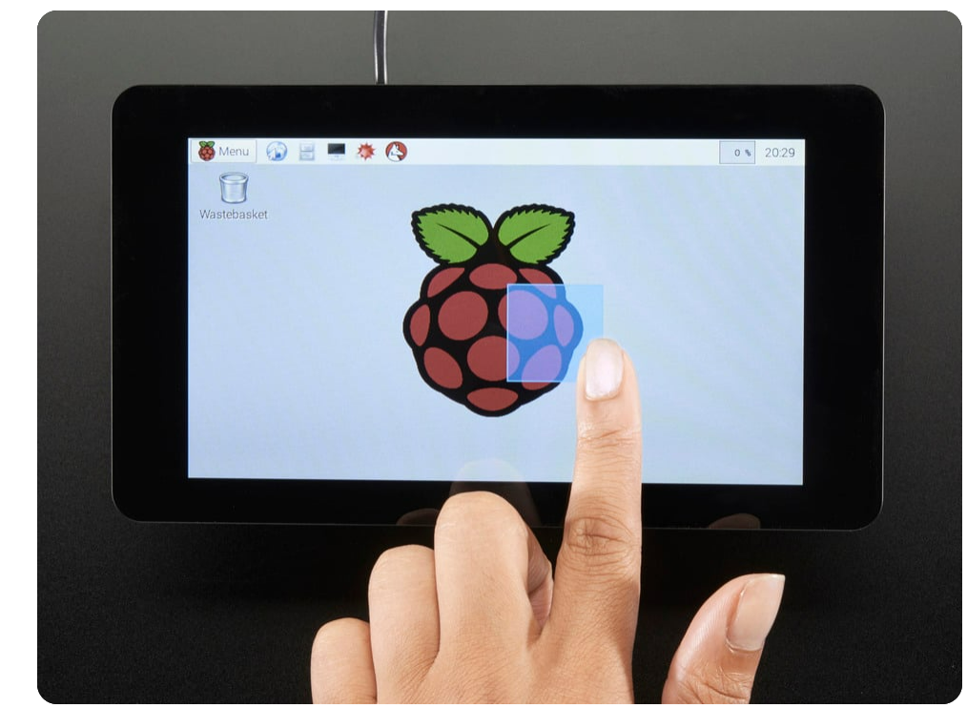
Touch Screens
7” Touch screen
Pi Foundation Display - 7" Touchscreen Display for Raspberry Pi
Display Development Tools The factory is currently not accepting orders for this product
Unit weight : 1.231 lbs
$99.94
Zahra Alnahwi
2/2/2023
Notes:
Put 5’’ touch screen on this page too. Also is 7” touch screen price, right?

Slide 13
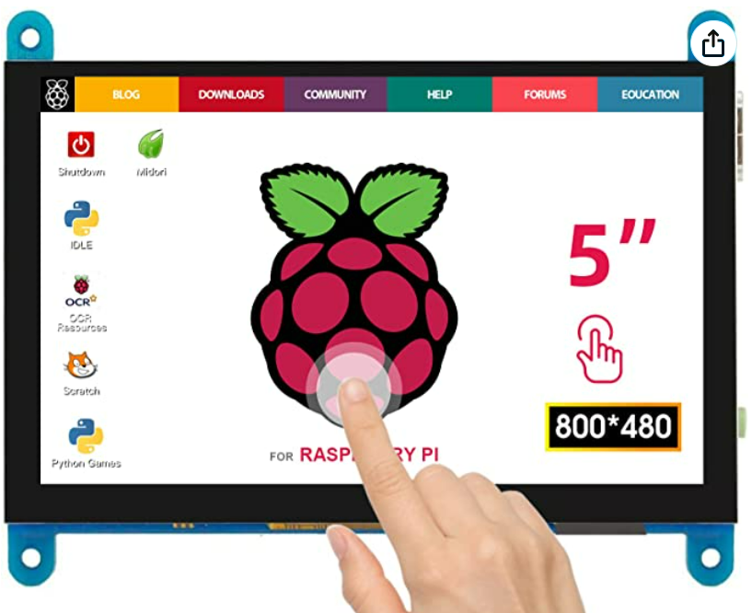
Touch Screen
5” Touch screen
ELECROW Raspberry Pi Touchscreen Monitor 5 inch
This 5 inch small HDMI capacitive touch screen LCD supports various systems with resolution of 800×480.
Unite weight : 4.13 ounces

Slide 14
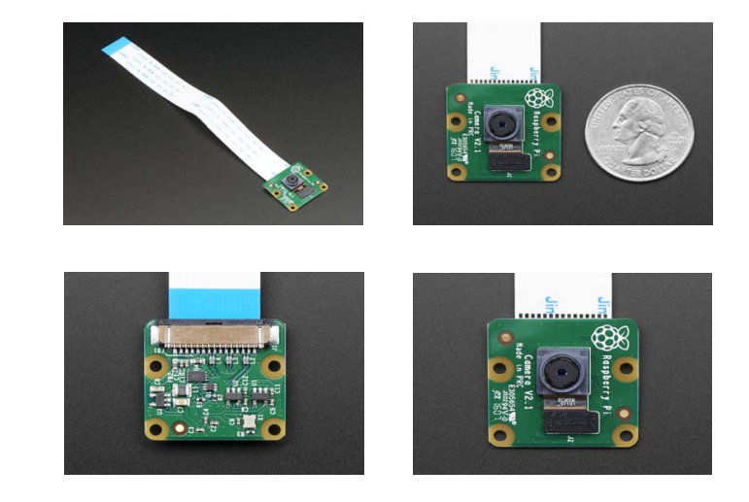
Camera
Raspberry Pi Camera Board v2 - 8 Megapixels
IMX219 Camera Sensor Raspberry Pi Platform Evaluation Expansion Board Weight (camera board + attached cable): 3.4g
$35.94
Zahra Alnahwi
2/2/2023

Slide 15
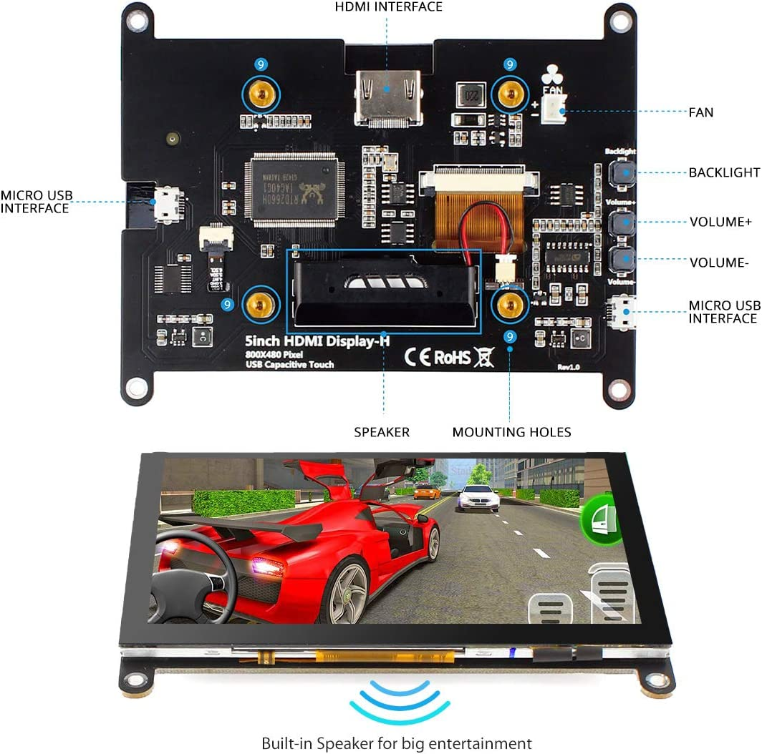
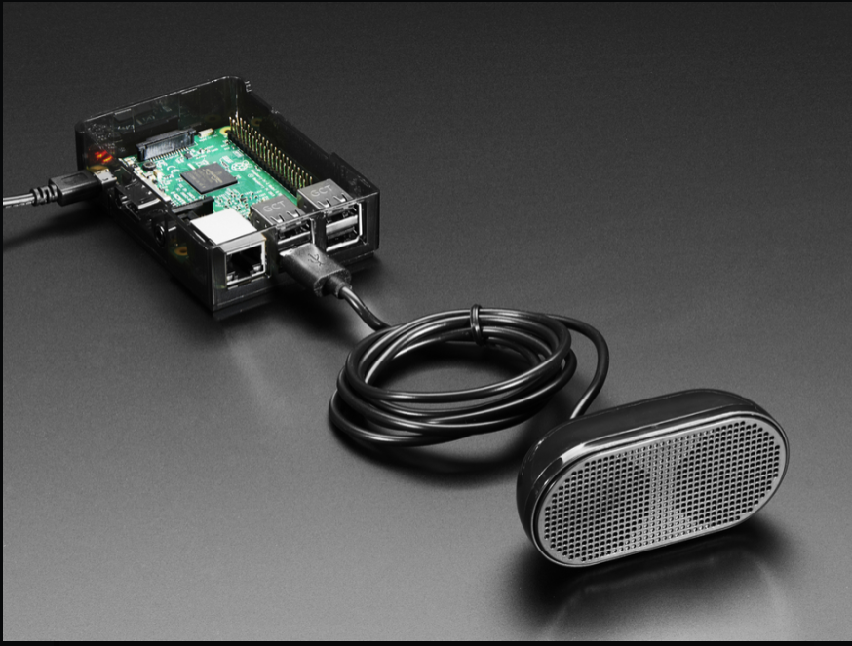
Speaker
We are still comparing the below options:
Using a screen with built in speaker
Using separate screen and speaker
$62
$13
Zahra Alnahwi
2/2/2023

Slide 16
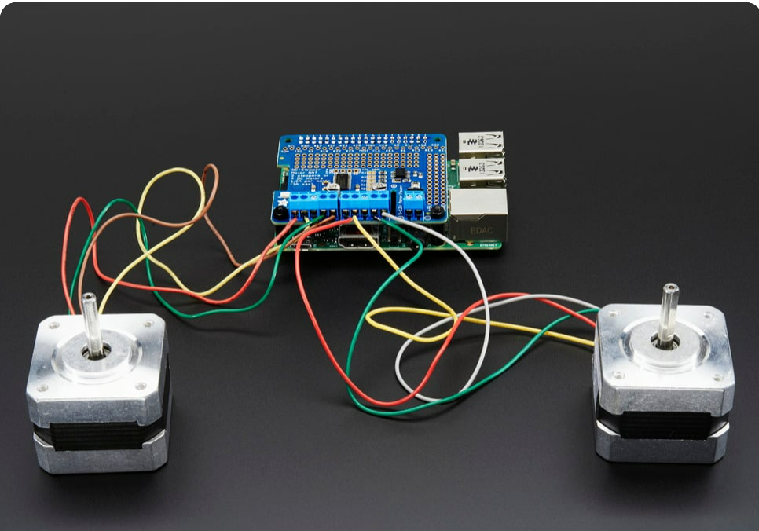
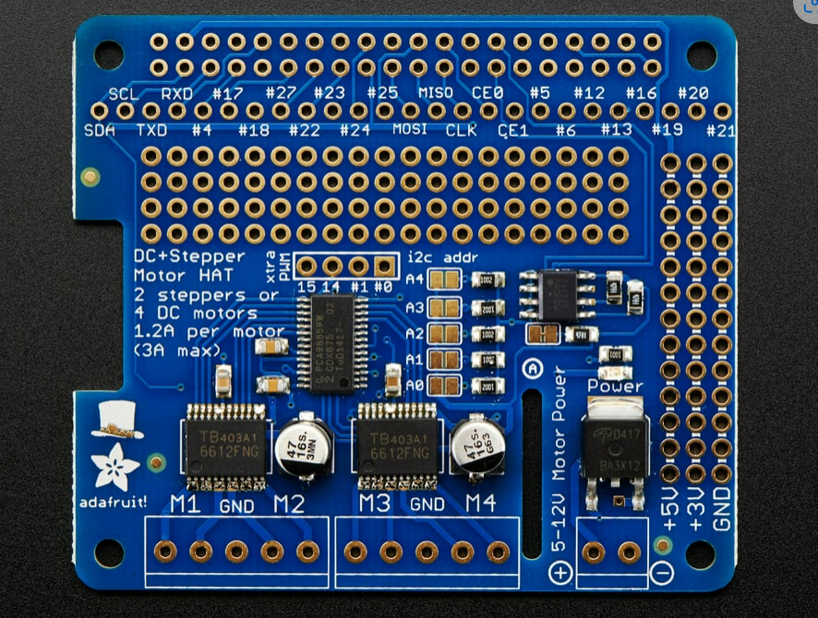
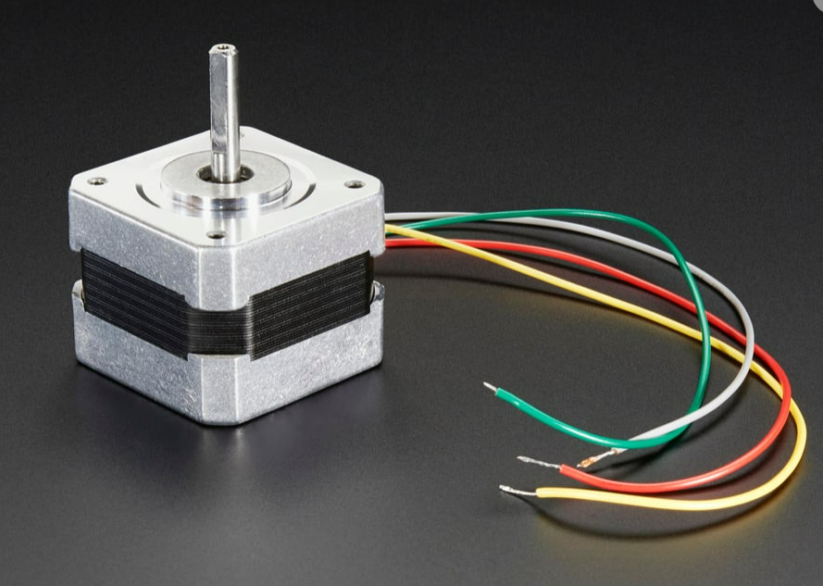
Motor
Adafruit DC & Stepper Motor HAT for Raspberry Pi
Adafruit DC & Stepper Motor HAT for Raspberry Pi - Mini Kit
Stepper motor - NEMA-17 size - 200 steps/rev, 12V 350mA
1- $22.50
2- $14
Zahra Alnahwi
2/2/23
Notes:
Add Servo Motor

Slide 17
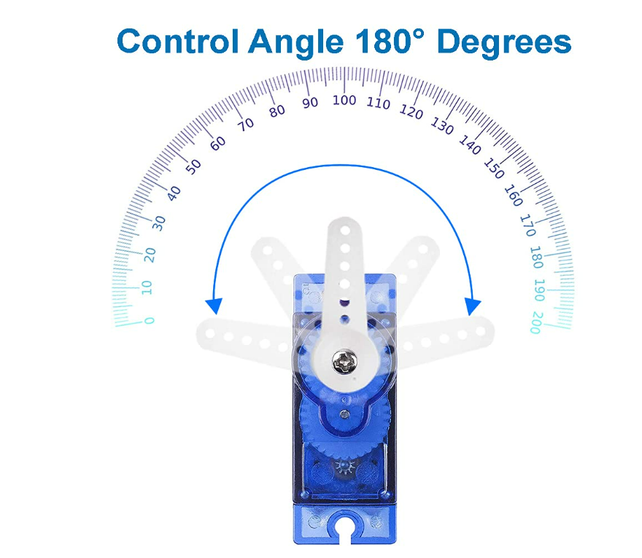
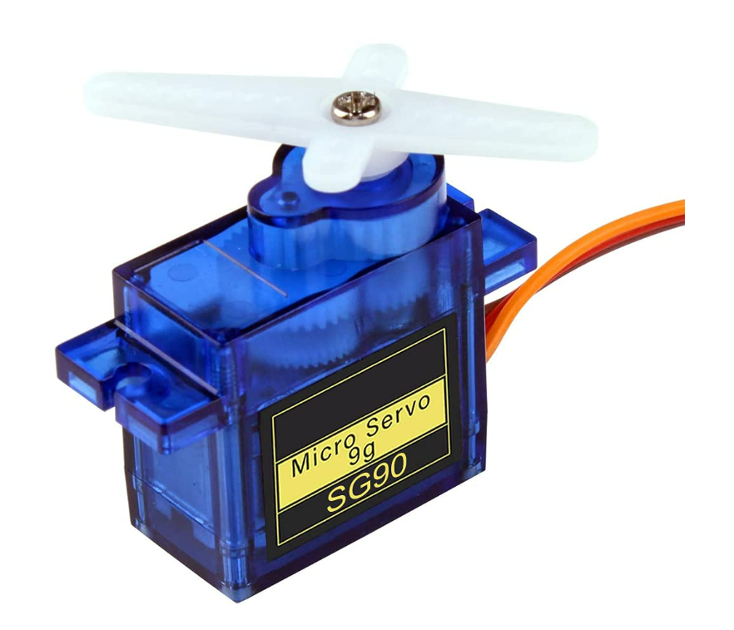
Motor
MMOBIEL SG90 9g Micro Servo Motor
$6.99

Slide 18
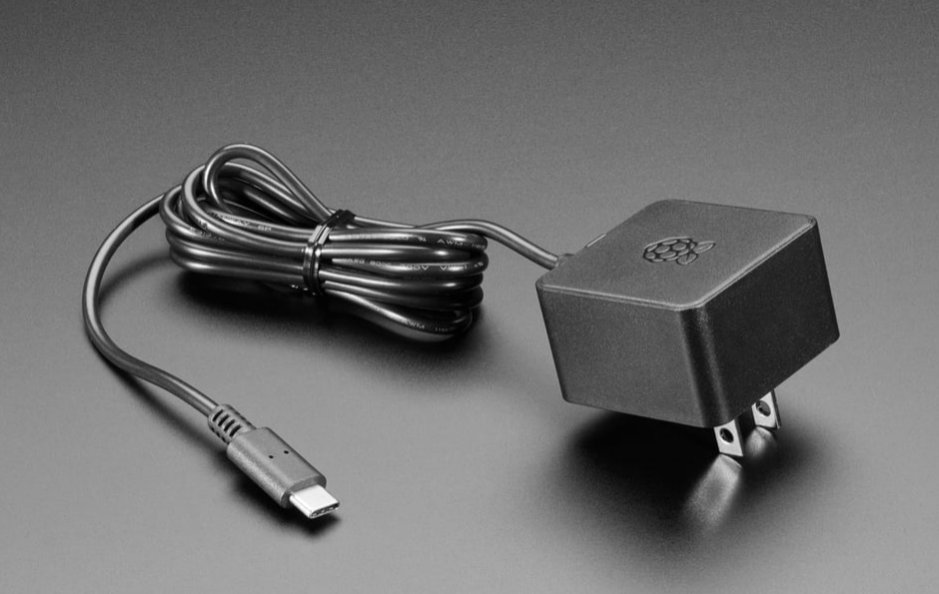
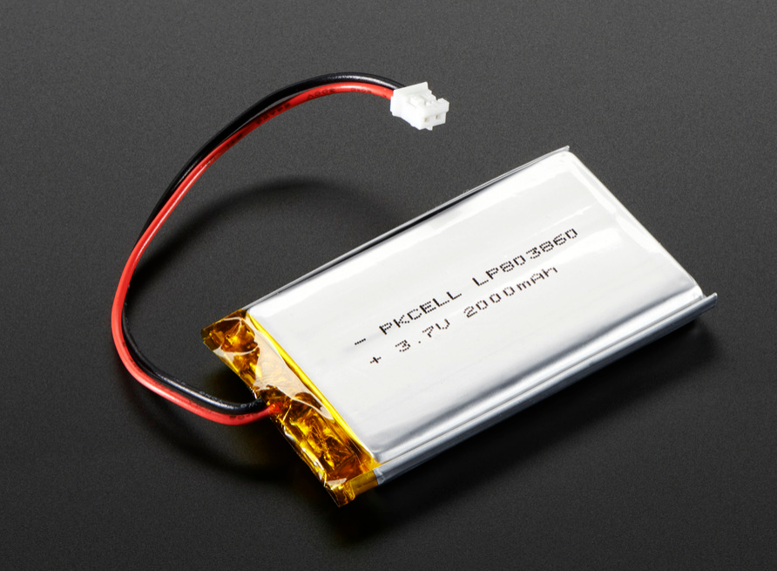
Power
We may use one of these options below:
Official Raspberry Pi Power Supply 5.1V 3A with USB C - 1.5 meter long
Lithium Ion Battery - 3.7V 2000mAh
1- $7.95
2- $12.50
Zahra Alnahwi
2/2/23

Slide 19
Software Design
Software:
Motor control will be coded with Python
Frontend
The Frontend will be powered by HTML and CSS
User interacts with the hardware interface
Backend
For the server’s framework we will use Python/Flask
For most of the backend development we will use JavaScript
Communicate information to third party
Control motors
Stephen Fransen
2/2/2023

Slide 20
User Interface Design
Always on Display:
Date
Time
Schedule Time
8:15:10 AM
2/2/2023
MONDAY
Morning:
8:15 am
Evening:
10:00 pm
Night:
8:00 pm
8:15:10 AM
2/2/2023
Alert Display:
Unlocks on Interaction
Settings
Snooze Alarm
Time
Schedule Time
MORNING PILLS
Take
Zarek & Daniel
2/2/2023

Slide 21
User Interface Design
Distribution Display:
Medication List
Live Camera View
Unlocks on Interaction
8:15:10 AM
2/2/2023
Pills Distributed
Camera
Take
Medication List:
A
B
C
8:15:10 AM
2/2/2023
Notifying Caregiver
Next Time: 12:00PM
Acknowledgement Display:
Confirmation Message
Next Medication Time
Medication List
Before & After Picture
DONEE
Before:
After:
Take
Medication List:
A
B
C
Zarek & Daniel
2/2/2023

Slide 22
Web Application Features
Web/Phone Application
Medication Notifications
Notified if patient has/has not taken their medication yet
List patient’s medication for upcoming period
Morning:
8:15 am
Evening:
10:00 pm
Night:
8:00 pm
Patient has not taken their morning medication
Patient’s Morning Medication
A
B
Stephen Fransen
2/2/2023

Slide 23
Web Application Features
Web/Phone Application
Medication Notifications
Notified if patient has/has not taken their medication yet
List patient’s medication for upcoming period
Medication Confirmation
Confirm patient has taken medication
Check on patient’s current condition
Morning:
8:15 am
Evening:
10:00 pm
Night:
8:00 pm
Patient Confirmation
Before
After
Patient’s Morning Medication
A
B
Stephen Fransen
2/2/2023

Slide 24
User Interface Design
Desired Outcome:
Simplicity
Easy to Use
Required Features:
Touch screen
Use it to unlock and access pills
Take photos before and after
Saved in database (remote cloud server)
Notification sent to caregiver after completion
Concerns:
Missed Medication
Beep for 20 Minutes
Notify Caregiver
Daniel Jacobs
2/2/2023

Slide 25
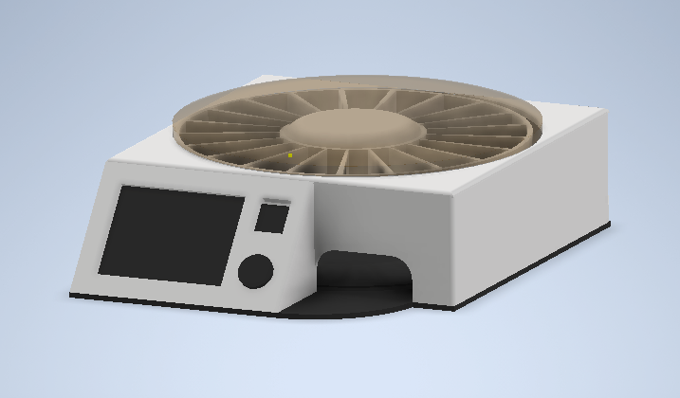
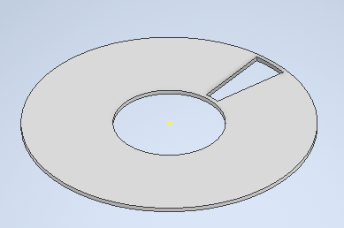
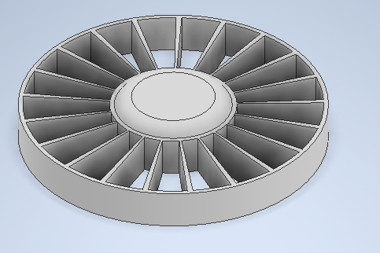
Design I (360 Pill Dispenser)
Features:
Rotating Disk Capsules
Clear Locking Lid
Mass Loading
Physical Labels
21 Day Supply
Benefits:
User Friendly
Familiarity
Simple Design
Concerns:
Manual Loading
Missed Medication
Zarek Rooker
2/2/2023
Notes:
Plastic Molding Cost?

Slide 26
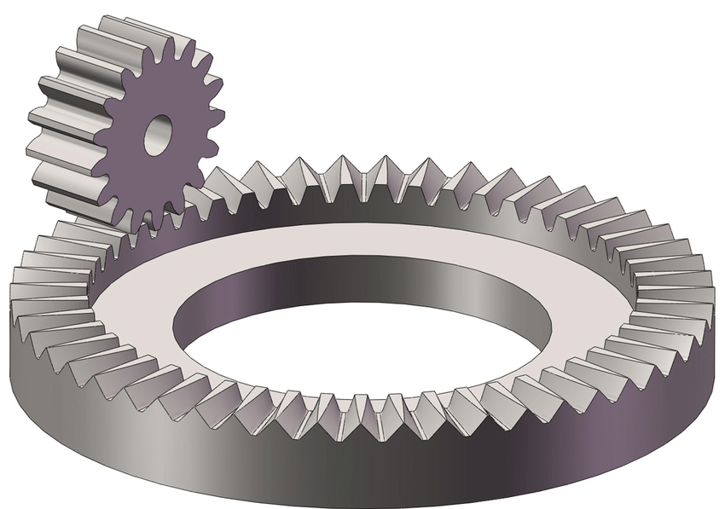
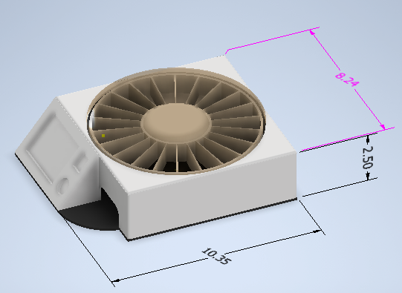
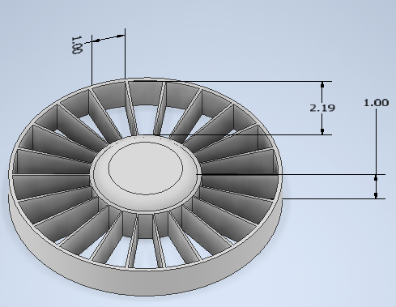
Design I (360 Pill Dispenser)
Parts:
Electronics
Raspberry Pi 4B, 3.5” Touchscreen, Speaker, Camera
Hardware
(2) Motors, Face Gear, Ball Bearings, Clear Plastic Molding
Dimensions:
Total Size – 10” x 2.5” x8”
Capsule - 1’’ x 2’’ x 1’’
Total Cost: $179
Electrical: $148
Hardware: $31
Zarek Rooker
2/2/2023

Slide 27
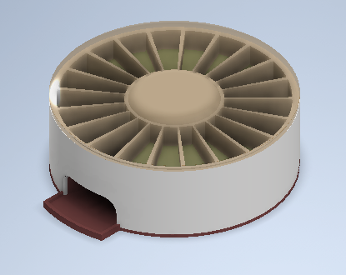
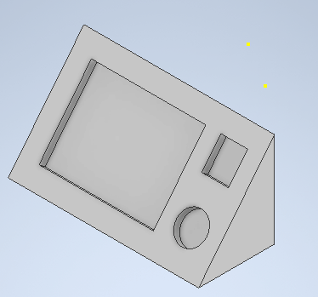
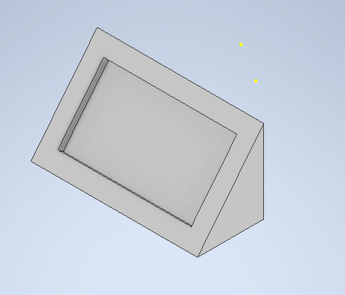
Design I (Alternatives)
Separate Touch Screen
Benefits:
Compatibility
“Cheaper”
Longevity/Timeless
Concerns:
Manual Loading
Connectivity
Speaker/Camera Location
Alternative Parts:
Raspberry Pi 4B & Pico
5” or 7” Touchscreen
Dimensions: 9’’ x 2.5’’ x 8’’
Total Cost: $188
Cost (Excluding Touch Screen): $133
Zarek Rooker
2/2/2023

Slide 28
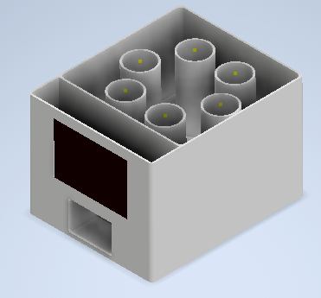
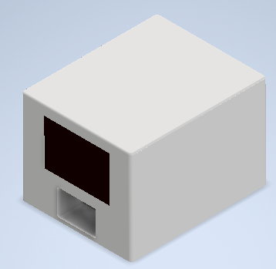
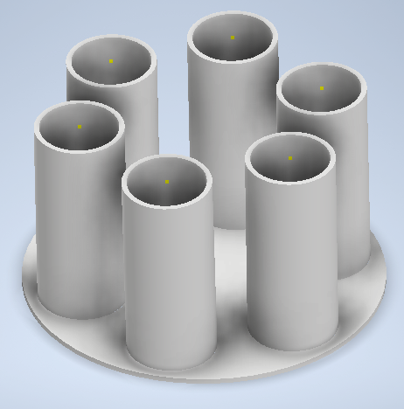
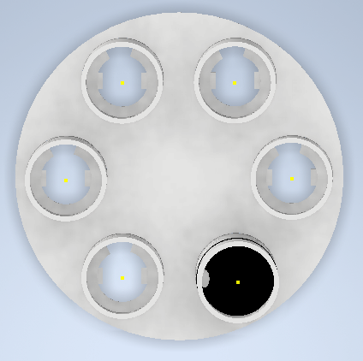
Design II (Smart Pill Dispenser)
Features:
Six Cylinders (Six Different Pills)
Automatic loading
Place All Pills in at once
Bottle Size Supply
Locking Lid Capsule
Benefits:
Easy Loading
Quick Setup
Concerns:
Different Pill Size
More than 6 different pills
Device Size
Cost
More Custom Parts
Mechanical Failure
Zarek Rooker
2/2/2023

Slide 29
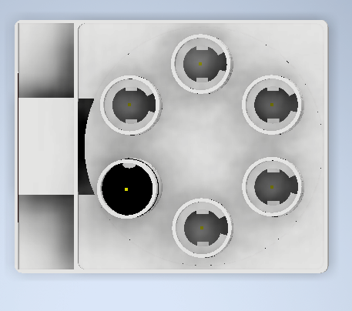
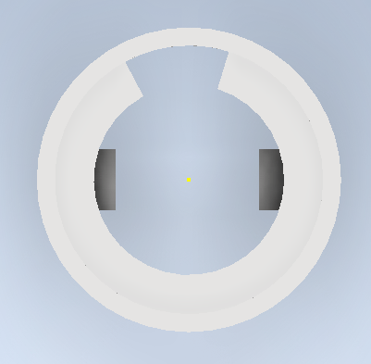
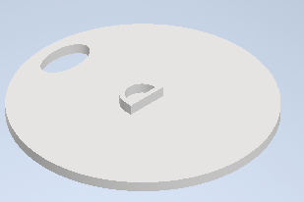
Design II (Smart Pill Dispenser)
Parts:
Electronics
Raspberry Pi 4B, 3.5” or 5’’ Touchscreen, Speaker, Camera
Hardware
(1) Stepper Motors, (6) Servo Motors, Face Gear, Ball Bearings
Adjustable Parts (For Different Pill Sizes)
Dimensions:
Total Size: 10’’ x 7.25’’ x 8’’
Total Cost: $203
Electrical: $152
Hardware: $51
Zarek Rooker
2/2/2023

Slide 30
Design II (Alternatives)
Alternative Designs:
Separate Touch Screen ($208)
Compatibility
Longevity/Timeless
Less Cylinders ($203)
Reduce Size
Tilted Cylinders ($196)
No Stepper Motor
Reduce Size
Alternative Parts:
Raspberry Pi 4B & Pico
5” or 7” Touchscreen
Dimensions: 9’’ x 7’’ x 6’’
Total Cost: ~$202
Cost (Excluding Touch Screen): ~$140
Zarek Rooker
2/2/2023

Slide 31
Design Cost Analysis
 | Design I (360 SPB) |  | Design III (Smart Dispenser)
 | Design I | Separate Touchscreen | Design III | Separate Touchscreen | Less Cylinders | Tilted Cylinders
Raspberry Pi 4B | $55 | $55 | $55 | $55 | $55 | $55
Raspberry Pi Pico |  | $5 |  | $5
Touchscreen | $45 | $62 | $62 | $62 | $62 | $62
Motors | $25 | $25 | $20+$10 | $20+$10 | $20+10 | $25
Speaker | $13
Camera | $35 | $35 | $35 | $35 | $35 | $35
3D Parts | $20 | $20 | $20 | $20 | $20 | $20
Ball Bearings | $4 | $4 | $4 | $4 | $4 | $4
Cost: | $197 | $206 | $206 | $213 | $206 | $201
No Screen Cost: |  | $151 |  | $151 |  | $139
Contingencies: | $71.6 | $75.6 | $80 | $83 | $81 | $78
ADD $8 for 7-inch touchscreen.
Contingencies: 30-50%
Zarek Rooker
2/2/2023

Slide 32
Decision Matrix
 | Design I (360 SPB) |  | Design II (Smart Dispenser)
 | Design I | Separate Touchscreen | Design II | Separate Touchscreen | Less Cylinders | Tilted Cylinders
User Friendly | 9 | 7 | 9 | 7 | 9 | 9
Easy Loading | 5 | 5 | 10 | 10 | 10 | 10
Simplicity | 8 | 7 | 5 | 5 | 5 | 6
Size | 9 | 10 | 7 | 7 | 7 | 8
Cost | 10 | 9 | 7 | 7 | 7 | 9
Less Risk | 10 | 8 | 6 | 6 | 6 | 6
Total Score: | 51 | 46 | 43 | 42 | 44 | 48
Scores 1 – 10: With 1 being the undesirable
10 being the desired.
Higher score is better
Zarek Rooker
2/2/2023

Slide 33
Testing and Experimentation
Hardware Testing:
Unit testing
What does each part do? Does it accomplish that function?
What are some design constraints?
Integration testing
Do parts fit together?
How does the system as a whole function?
Electrical testing:
Unit testing
Are individual components functional?
Can we make the components behave as desired?
Are the components a good fit to accomplish the task?
Integration testing
Do the parts work well together?
Software Testing:
Unit testing
Server communication?
UI?
Backend?
Integration Testing
Does the backend handle inputs from the front end correct?
Does the information transfer between the server and the smart pillbox correctly?
Daniel Jacobs
2/2/2023

Slide 34
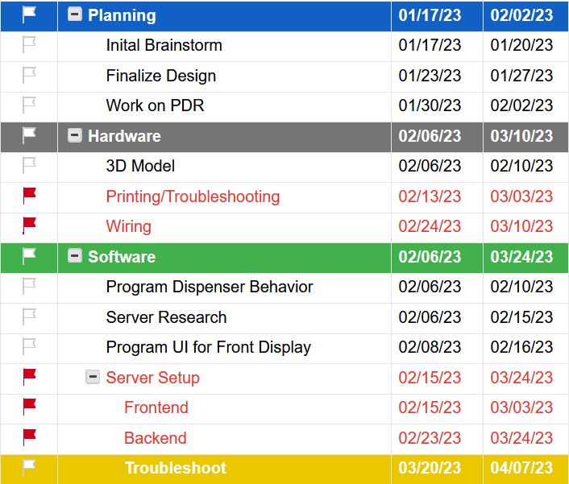
Project Plan
Stephen Fransen
2/2/2023

Slide 35
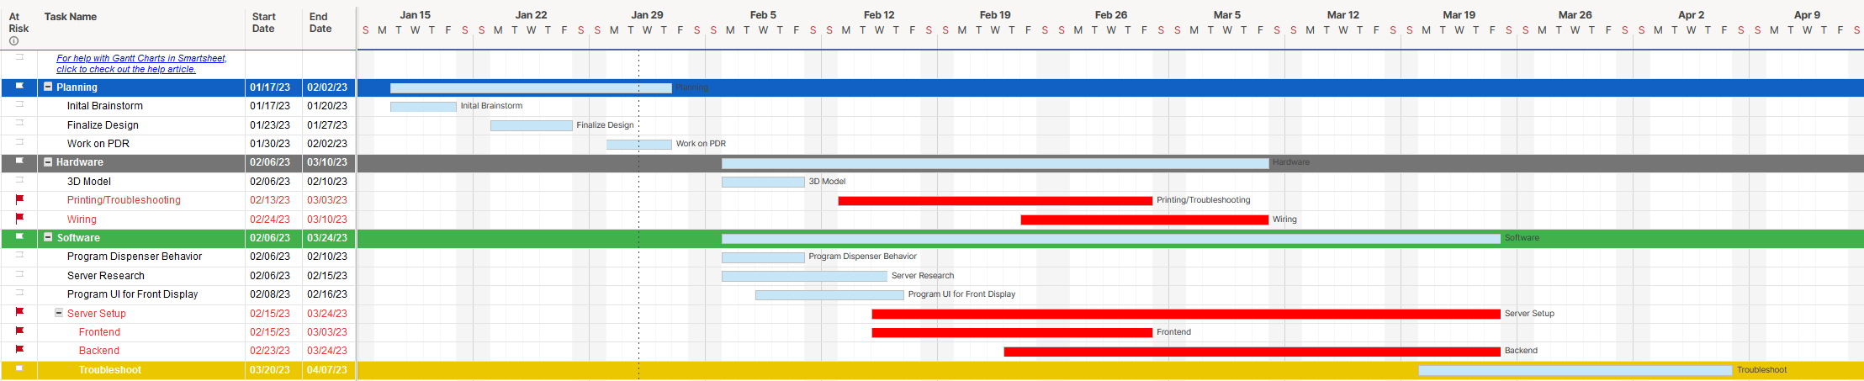
Project Plan
Stephen Fransen
2/2/2023

Slide 36
Risk Management
Impact
 | Negligible | Minor | Moderate | Significant | Severe
Very Likely | 3D Printer Failure
Likely |  |  |  | Server/Networking Issues
Possible | Motor Failure | Selected Parts are Unavailable | Broken Parts/Screens
Unlikely |  |  |  | Design Does Not Meet Specification
Very Unlikely
Likelihood
Stephen Fransen
2/2/2023

Slide 37
Hazard Analysis
Wrong Drug Dosage: Smart pill boxes may have inaccurate dosages if users forget to double-check their input or if the machine malfunctions
Mitigation Strategy:
Keep and display a record of all medications taken and dosages.
Malfunctioning: The smart pill box may malfunction due to programming errors, hardware issues, or power outages, leading to incorrect prescriptions being dispensed.
Mitigation Strategy:
Regularly check and maintain the device to ensure it is functioning properly. Implement a redundancy system that can detect any errors and alert the user.
Zarek Rooker
2/2/2023

Slide 38
Hazard Analysis
Accidental Overdose: Overdose of medication due to incorrect dosage settings or incorrect usage of the device.
Mitigation Strategy: Educate users on how to use the device correctly, including instructions on how to set the dosage, and provide an emergency contact number in case of accidental overdose. The smart pill box should be programmed to alert the user if too many doses are taken in a day.
Security and privacy risks: Data stored on the device may be accessed by unauthorized users.
Mitigation Strategy: Utilize encryption technology to protect user data from being accessed by unauthorized users and to prevent data tampering. Additionally, provide a secure login system with password protection.
Zarek Rooker
2/2/2023

Slide 39
Cost
Name | Quantity | Price
Raspberry Pi | 1 | $55.00
Display | 1 | $100.00
Camera | 1 | $35.94
Speaker | 1 | $13.00
Motor | 7 | $14.00
Adafruit DC & Stepper Motor | 1 | $22.50
Power | 1 | $12.50
 | Total Price | $323.94
 | Proposed Cost | $400.00
Zahra Alnahwi
2/2/2023

Slide 40
Presentation Work Disbursement
Zarek- Description, Design Constraints, Considerations, Hardware Design (I & II), Hazard Analysis
Zahra- Parts Research, Price Research , and Schematic
Stephen- Risk Management, Software Design, Project Plan, Web Application Features
Daniel – Testing, Decision Matrix, and Experimentation

Slide 41
Questions?

Slide 42
References:
Prescription drug statistics 2022 (singlecare.com)
Medication overload and older Americans - Lown Institute

